Slide 1
Model Quantization with Calibration Keeping Inference Accuracy using Quantized Models Under Control

Slide 2
Two Algorithms of Quantizing FP32 into INT8
Which one is better?
Ref: http://on-demand.gputechconf.com/gtc/2017/presentation/s7310-8-bit-inference-with-tensorrt.pdf

Slide 3
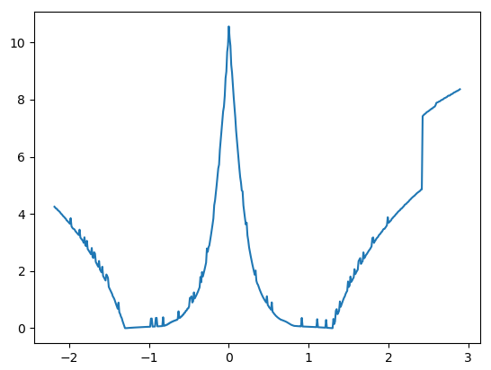
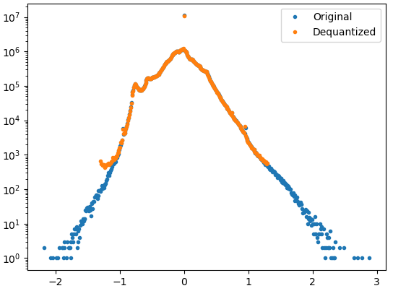
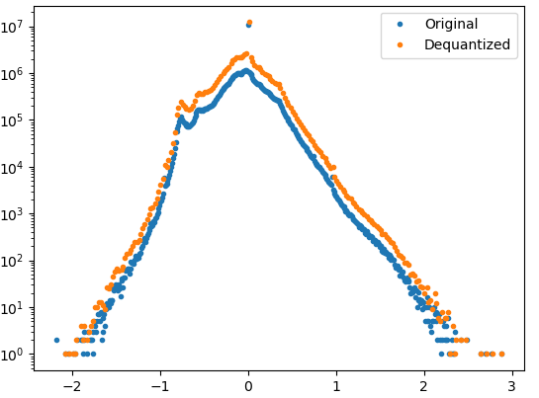
Quantifying Information Loss from Quantization
KL divergence of FP32 data distribution and its INT8 data distribution. There is a minimum point between zero and the max(data).
KL Divergence
threshold
Smaller thresholds tend to keep the distribution of high frequency values, which have been observed more impactful to inference accuracy than the values in the long tail.

Slide 4
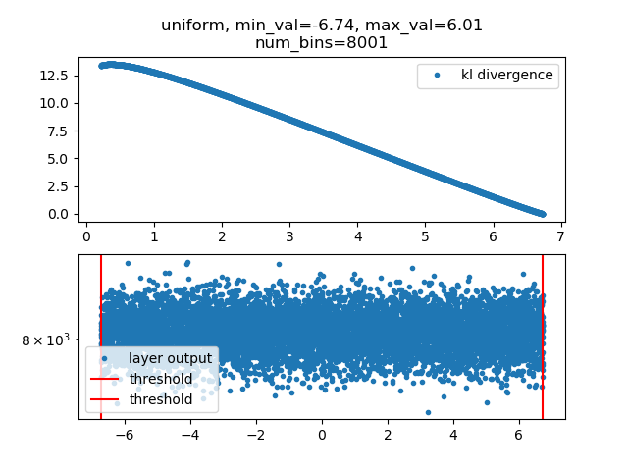
Optimal Thresholds for Quantizing Layer Outputs
In a uniform distribution, every value is equally distributed and there is no long tail. The optimal thresholds should be max(abs(data)).
In a distribution generated by a convolution operator from Resnet-152, the long tail values can be saturated in order to keep the KL divergence minimal.

Slide 5
Example of FP32 and Quantized (INT8) Models
Input (float32)
FP32 data
min
max
Input (float32)
min (float)
max (float)
quantize
Need to either calculate thresholds for INT8 quantization at runtime or pre-calculate them using a calibration dataset.
FP32
Convolution
An example of quantizing a FP32 network
INT8 data
min (float)
max (float)
quantized_conv2d
FP32
BatchNorm
INT32 data
min (float)
max (float)
requantize (from INT32 to INT8)
FP32
INT8 data
min (float)
max (float)
Relu
dequantize
FP32
FP32
BatchNorm
Output (float32)
FP32
Relu
FP32 Model
FP32
Ref: https://www.tensorflow.org/performance/quantization
Output (float32)
Quantized Model

Slide 6
MXNet Model Quantization API
sym: FP32 model symbol
params: Pre-trained PF32 model parameters
excluded_sym_names: Symbol lists containing the nodes in the network excluded from being quantized
calib_mode: ”none”, “naive”, “entropy”
calib_data: Calibration dataset iterator
num_calib_examples: Number of examples used for calibration from the calibration dataset
calib_layer: A function returning True or False for determine whether to calibrate a layer by taking its name as input
ctx: Context on which running forward propagation using FP32 model to collect statistics from calibration dataset
logger: A logger
Returns: cqsym, qarg_params, aux_params

Slide 7
Quantized Model Inference Accuracy Comparison (Unit: %)
 | FP32 |  | INT8
 |  |  | No Calibration |  | Calibration using 5 batches |  | Calibration using 10 batches |  | Calibration using 50 batches |  | Calibration Method
NETWORK | Top1 | Top5 | Top1 | Top5 | Top1 | Top5 | Top1 | Top5 | Top1 | Top5
Resnet-152 by MXNet | 77.19 | 93.01 | 75.56 | 92.32 | 75.58 | 92.24 | 75.58 | 92.17 | 75.34 | 92.04 | Threshold by min/max
 |  |  |  |  | 75.65 | 92.35 | 75.73 | 92.29 | 75.61 | 92.35 | Threshold by entropy loss
Resnet-152 by NVIDIA | 74.78 | 91.82 |  |  | 74.62 | 91.82 | 74.66 | 91.82 | 74.70 | 91.78 | Threshold by entropy loss
NETWORK | Top1 | Top5 | Diff Top1 | Diff Top5 | Diff Top1 | Diff Top5 | Diff Top1 | Diff Top5 | Diff Top1 | Diff Top5
Resnet-152 by MXNet | 77.19 | 93.01 | 1.63 | 0.69 | 1.61 | 0.77 | 1.61 | 0.84 | 1.85 | 0.97 | Threshold by min/max
 |  |  |  |  | 1.54 | 0.66 | 1.46 | 0.72 | 1.58 | 0.66 | Threshold by entropy loss
Resnet-152 by NVIDIA | 74.78 | 91.82 |  |  | 0.15 | 0.01 | 0.11 | 0.01 | 0.08 | 0.05 | Threshold by entropy loss
Batch size: 32
Number of batches for inference: 500 (not used for calibrations)
Platform: p3.8xlarge
Shuffle validation dataset: True, shuffle_chunk_seed=3982304, seed=48564309
Model URL: http://data.mxnet.io/models/imagenet/resnet/152-layers/
NVIDIA Results URL: http://on-demand.gputechconf.com/gtc/2017/presentation/s7310-8-bit-inference-with-tensorrt.pdf, page 30

Slide 8
Quantized Model Inference Accuracy Comparison (Unit: %)
 | FP32 |  | INT8
 |  |  | No Calibration |  | Calibration using 5 batches |  | Calibration using 10 batches |  | Calibration using 50 batches |  | Calibration Method
NETWORK | Top1 | Top5 | Top1 | Top5 | Top1 | Top5 | Top1 | Top5 | Top1 | Top5
Inception w/ BN MXNet | 72.38 | 90.61 | 71.98 | 90.26 | 71.78 | 90.26 | 71.81 | 90.29 | 71.68 | 90.26 | Threshold by min/max
 |  |  |  |  | 71.98 | 90.36 | 71.90 | 90.34 | 72.00 | 90.34 | Threshold by entropy loss
GoogleNet by NVIDIA | 68.57 | 88.83 |  |  | 68.21 | 88.67 | 68.10 | 88.58 | 68.12 | 88.64 | Threshold by entropy loss
NETWORK | Top1 | Top5 | Diff Top1 | Diff Top5 | Diff Top1 | Diff Top5 | Diff Top1 | Diff Top5 | Diff Top1 | Diff Top5
Inception w/ BN MXNet | 72.38 | 90.61 | 0.40 | 0.35 | 0.60 | 0.35 | 0.57 | 0.32 | 0.70 | 0.35 | Threshold by min/max
 |  |  |  |  | 0.40 | 0.25 | 0.48 | 0.27 | 0.38 | 0.27 | Threshold by entropy loss
GoogleNet by NVIDIA | 68.57 | 88.83 |  |  | 0.36 | 0.16 | 0.46 | 0.25 | 0.45 | 0.19 | Threshold by entropy loss
Batch size: 32
Number of batches for inference: 500 (not used for calibrations)
Platform: p3.8xlarge
Shuffle validation dataset: True, shuffle_chunk_seed=3982304, seed=48564309
Model URL: http://data.mxnet.io/models/imagenet/inception-bn/
NVIDIA Results URL: http://on-demand.gputechconf.com/gtc/2017/presentation/s7310-8-bit-inference-with-tensorrt.pdf, page 30

