Slide 2
MATH WAR
Jose Luis Castro – Jcastrogo@unal.edu.co
Gabriel Bustos - Gbustosm@unal.edu.co
Heider Navarro - hnavarroq@unal.edu.co
Pablo Saurez – psuarezv@unal.edu.co
Facultad de ingeniería – POO - Sede Bogotá

Slide 3
Problem Statement
Deficiency in knowledge in the area of ​​mathematics in the university community.
The most deficient subject in general is calculations.
Sede Bogotá
Facultad de ingeniería
Programación Orientada a Objetos
Néstor German Bolívar Pulgarín – nbolivar@unal.edu.co

Slide 4
What are our objectives?
Complete multiple minigames that helps to learn mathematics
Stimulate the learning of mathematical knowledge in a didactical way
Create an interface that helps the user to navigate around our mini games
Sede Bogotá
Facultad de ingeniería
Programación Orientada a Objetos
Néstor German Bolívar Pulgarín – nbolivar@unal.edu.co

Slide 5
What are our challenges?
Github
Handle new unity tool due to its differences with java
The implementation of the C# library, having to perform tasks that we never imagined how they would be.
Make an algorithm to graph the functions
Sede Bogotá
Facultad de ingeniería
Programación Orientada a Objetos
Néstor German Bolívar Pulgarín – nbolivar@unal.edu.co

Slide 6
What is the project tracking tool?
GitHub
Jira
Unity
Sede Bogotá
Facultad de ingeniería
Programación Orientada a Objetos
Néstor German Bolívar Pulgarín – nbolivar@unal.edu.co

Slide 7
What were our results?
Sede Bogotá
Facultad de ingeniería
Programación Orientada a Objetos
Néstor German Bolívar Pulgarín – nbolivar@unal.edu.co

Slide 8
Sede Bogotá
Facultad de ingeniería
Programación Orientada a Objetos
Néstor German Bolívar Pulgarín – nbolivar@unal.edu.co

Slide 9
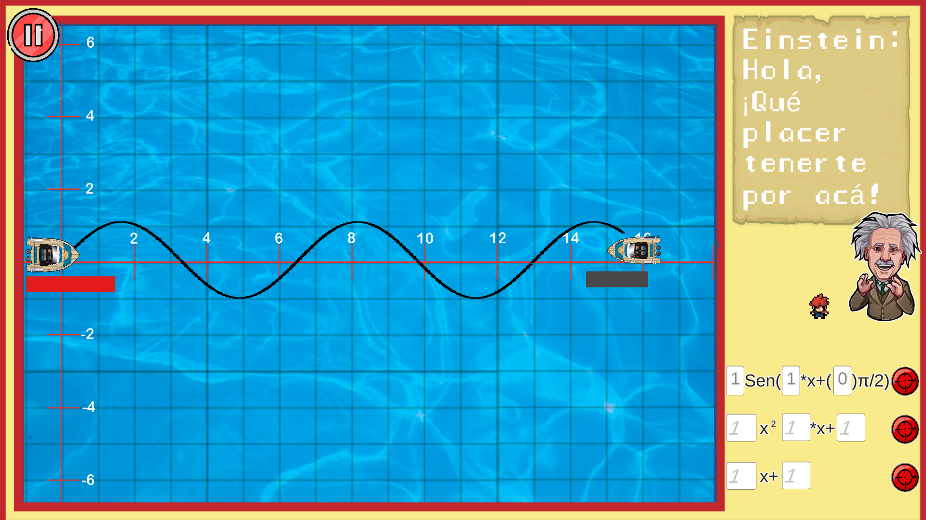
What were our results?
Sede Bogotá
Facultad de ingeniería
Programación Orientada a Objetos
Néstor German Bolívar Pulgarín – nbolivar@unal.edu.co

Slide 10
Math - war
https://drive.google.com/drive/u/1/folders/1WE9GIirvysHV7EO1lP_3tUKY5B__Wiiy
https://github.com/Pab10Suarez/Mathwars
https://githup-integration.atlassian.net/jira/software/projects/MW/boards/1
Sede Bogotá
Facultad de ingeniería
Programación Orientada a Objetos
Néstor German Bolívar Pulgarín – nbolivar@unal.edu.co

Slide 11
Thanks.

