Slide 1
Azure Cognitive Service – Face API

Slide 2
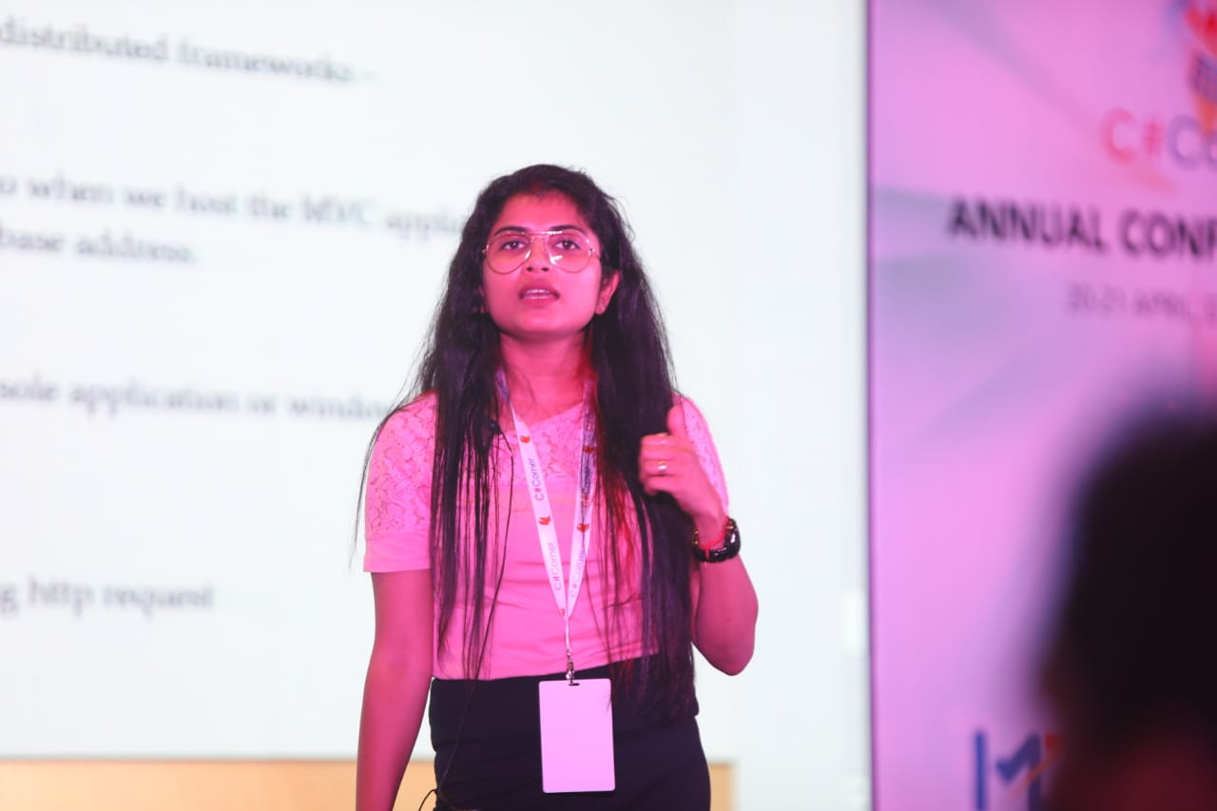
About Niloshima
Cloud Architect, Mentor, Blogger, Speaker and a Developer by Choice
12 years of Microsoft Technologies in Services/Products in IT
Ex Morgan Stanley, Philips, RBS, Fiserv and more
Email – Niloshima@breewingcodes.com
LinkedIn:-
https://www.linkedin.com/in/niloshimasrivastav/

Slide 3
Getting Started with Face API
Provisioning Face API – Portal
Provisioning Face API – CLI
Testing Face API – Postman
Face Detection
Demo – Consume API in .NET Application
Agenda

Slide 4
Microsoft AI Stack – The Big Picture

Slide 5
Cognitive Services
Vision
Speech
Language
Decision
Web Search

Slide 6
Getting Started with Face API
Simple HTTP Web API
Detection
Identification
Verification
Face Grouping
Find Similar

Slide 7
Provision Face API - Azure Portal

Slide 8
Provision Face API - Azure CLI

Slide 9
First Call to Face API – via Postman

Slide 10
Face Detection
Location (Face Rectangle)
Landmarks
Unique ID
Attributes – age, gender, emotion etc.

Slide 11
Demo – Consuming Face API in .NET Application

Slide 12
QnA

