Slide 1
Microsoft Learn Student Ambassadors
@knowShubhangi
By Shubhangi Gupta

Slide 2
Microsoft Learn Student Ambassadors
@knowShubhangi
Be a Force for Good !
Join the Global Community
Make a difference
Grow your skills
Empower your community
Become a leader

Slide 3
Microsoft Learn Student Ambassadors
@knowShubhangi
Benefits

Slide 4
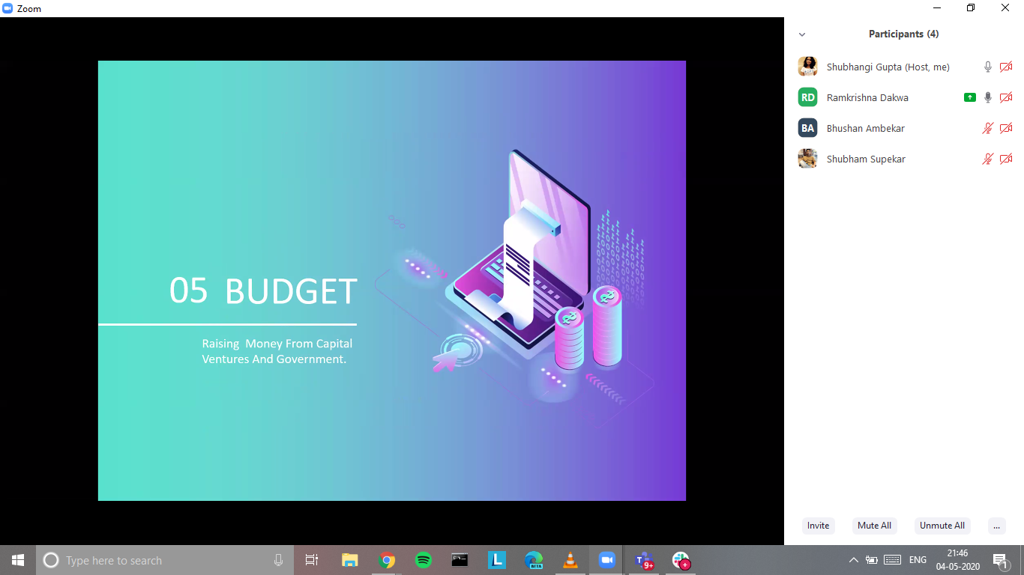
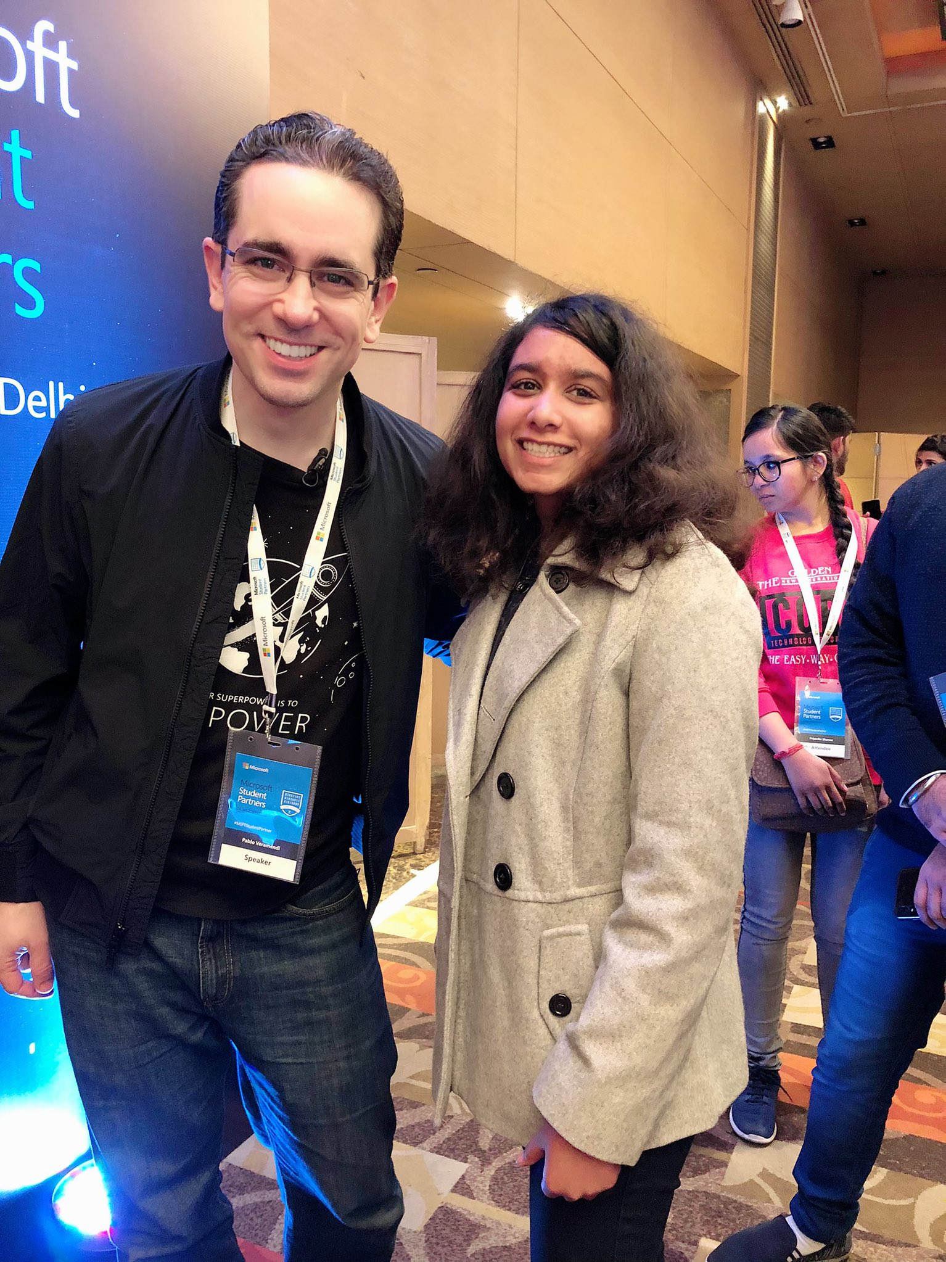
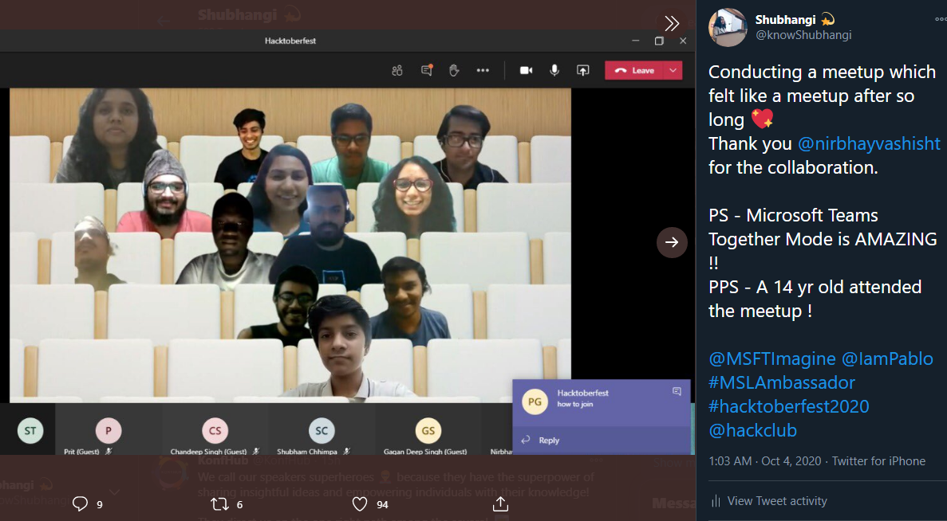
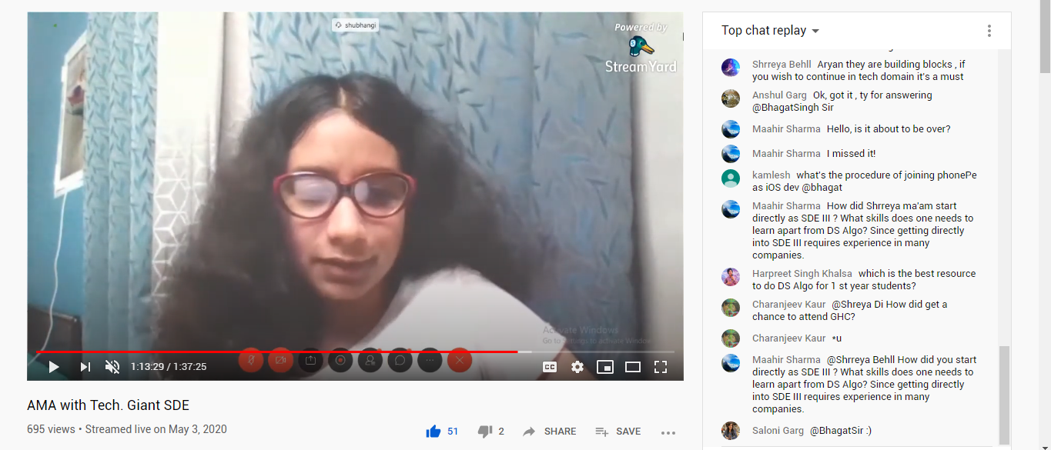
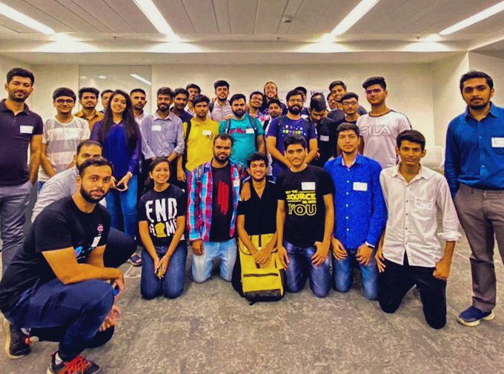
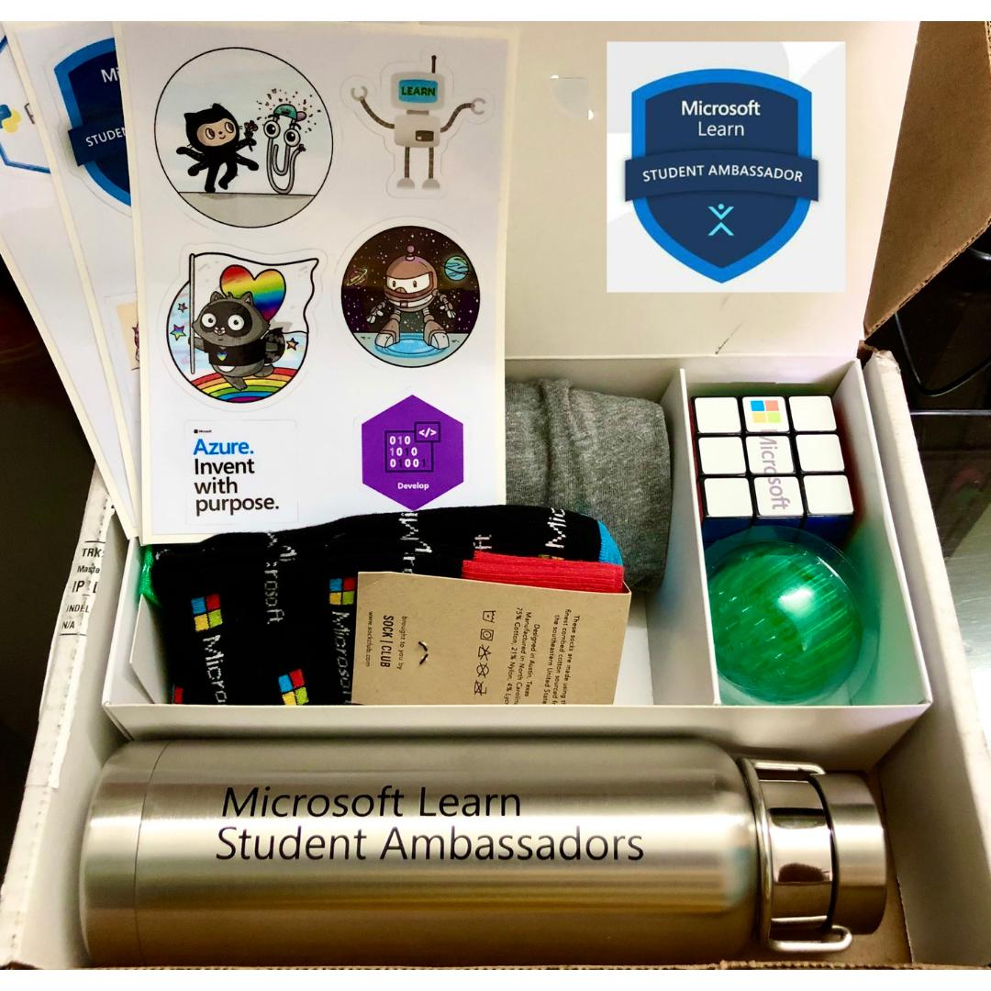
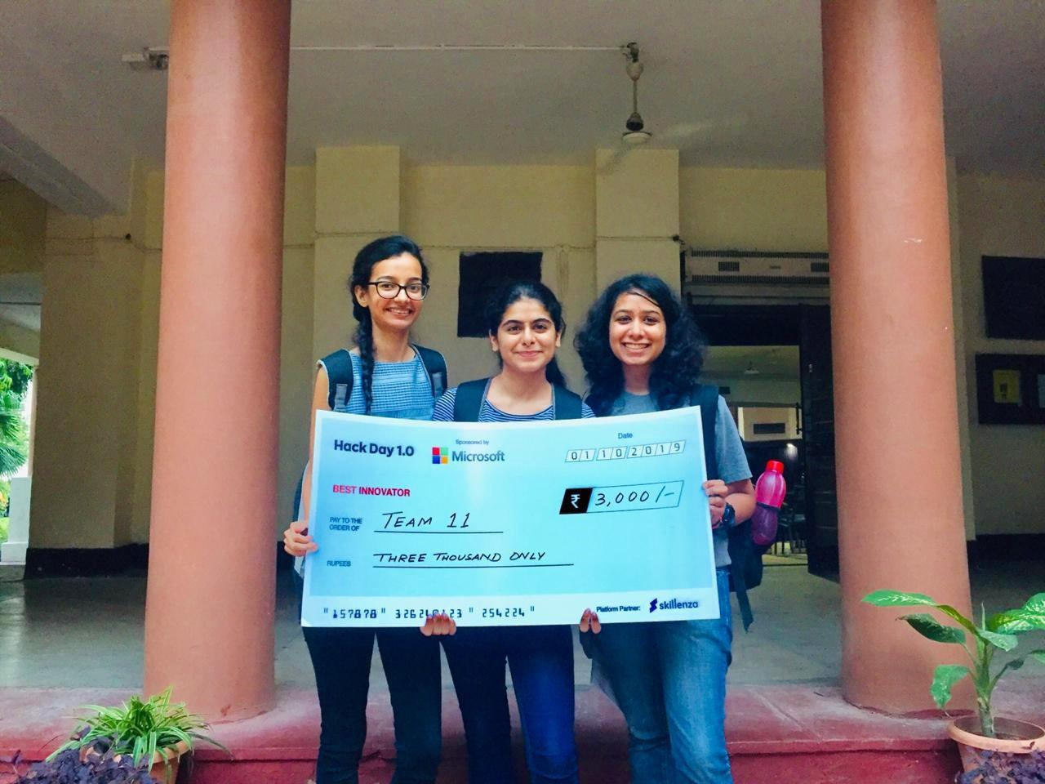
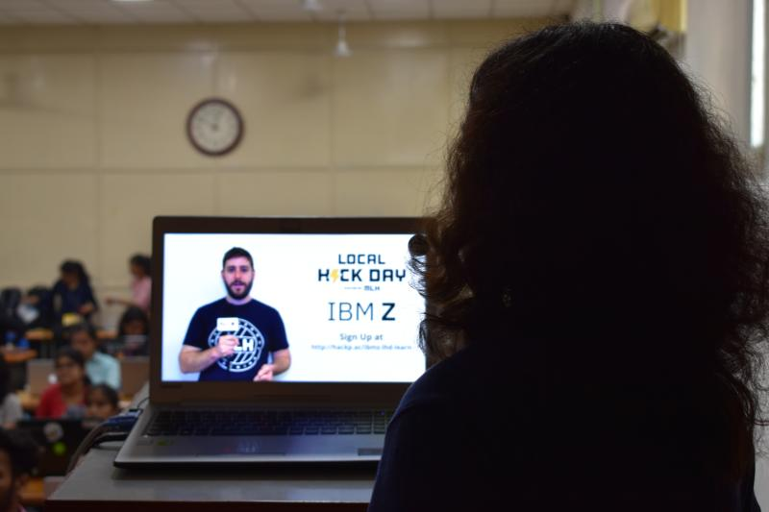
Microsoft Learn Student Ambassadors
@knowShubhangi
My Journey

Slide 5
Microsoft Learn Student Ambassadors
@knowShubhangi
Application Process
New students are accepted quarterly
Students from all backgrounds can apply
Video or Written Sample on
Inspire
Teach
Promote

Slide 6
Apply at studentambassadors.microsoft.com
Microsoft Learn Student Ambassadors
@knowShubhangi

Slide 7
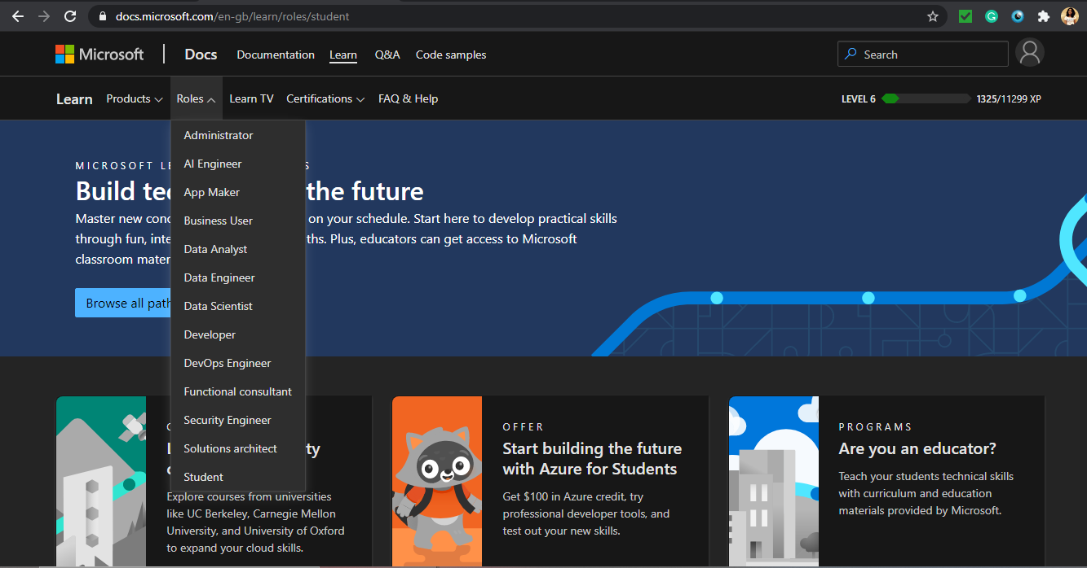
Microsoft Learn Student Ambassadors
@knowShubhangi
Microsoft Learn
Reference - https://docs.microsoft.com/en-gb/learn/roles/student

Slide 8
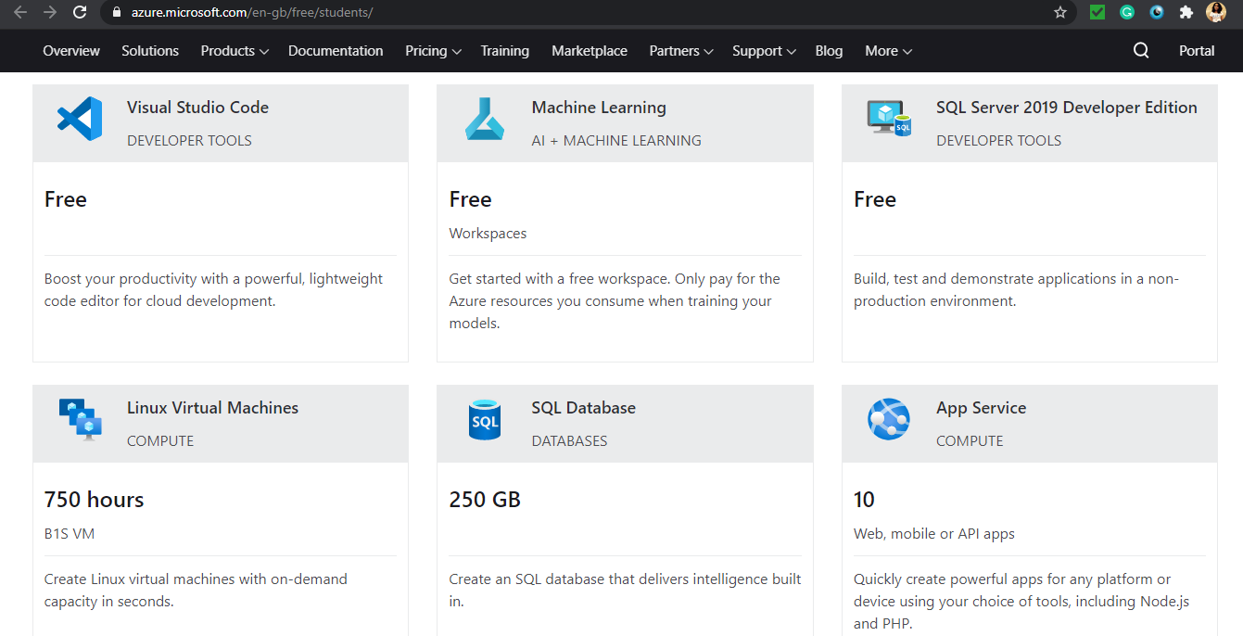
Microsoft Learn Student Ambassadors
@knowShubhangi
Microsoft Azure
Reference - https://azure.microsoft.com/en-gb/free/students/

Slide 9
Microsoft Learn Student Ambassadors
@knowShubhangi
Connect with me !
twitter.com/knowShubhangi
www.linkedin.com/in/knowShubhangi

Slide 10
Microsoft Learn Student Ambassadors
@knowShubhangi
Participate in Imagine Cup !
imaginecup.microsoft.com

