Slide 1
Personal Voice Assistant for PC
Submitted By:
Ali Nasir (193310004)
Farheen Bano (193310022)
Aakash Khanderao (193310020)
Mohit Kumar (193310019)
Machine Learning for Remote Sensing-I
GNR-652

Slide 2
MOTIVATION AND WORK DISTRIBUTION
Pe r sona l
Vo I ce
As s I s t ant
We have always been fascinated by how Siri, Alexa, Google Assistant or any other voice assistant works. It makes the lives of the user a lot easier by automating tasks. While reading about the applications of Machine learning in our day to day lives we became quite fascinated by the fact that this so called automated bots are emerged from the basic ML codes. We had our knowledge of Machine learning course with us and so we tried to carry it to advance levels with the help of this course.
Therefore, we decided to build our own voice assistant which would gather commands from the microphone on laptop and use it to perform a task.
Aakash Khanderao (193310020)
Mohit Kumar (193310019)
Ali Nasir (193310004)
Farheen Bano (193310022)
Research for the topic/Literature Study
Collection of relevant articles.
Use of libraries
Preprocessing methods
Data Collection and generation of sample audio sets.
Implementation of working code
Selection and development of algorithm/Use of CNN
Output and results evaluation.
GNR-652

Slide 3
Dataset Generation
Pe r sona l
Vo I ce
As s I s t ant
We chose 5 simple commands that we might frequently use and decided to record speaking those commands. We assumed that there will not be any background noise when the user speaks a command.
The five commands are:
‘Decrease Volume’ — Decrease system volume
‘Increase Volume’ — Increase system volume
‘Open Google’ — Open google webpage in a browser
‘Show CPU Utilization’ — Show performance details of running processes
‘Take a Picture’ — Use laptop camera to click a picture
We required a considerable amount of data for each class. we used the following code to record 20 samples for each command with slight variations on tempo and tone through laptop microphone. Each sample is 2 seconds long as it is just greater than the average amount of time it would take anyone to speak any of the commands.
GNR-652

Slide 4
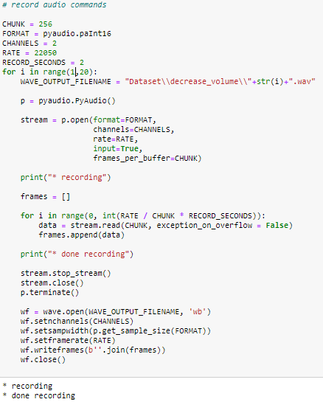
Dataset Generation
Pe r sona l
Vo I ce
As s I s t ant
The code for data generation of all 5 commands:
GNR-652

Slide 5
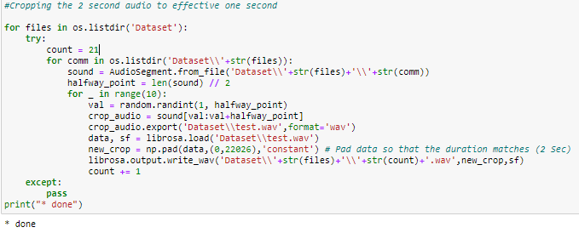
Dataset Generation
Pe r sona l
Vo I ce
As s I s t ant
We took random 1-second crops from the recorded 20 samples and append it with 1-second silence. This provided us with a significant amount of data for each class. We took 110 such crops each, and thus, got 550 Samples total.
GNR-652

Slide 6
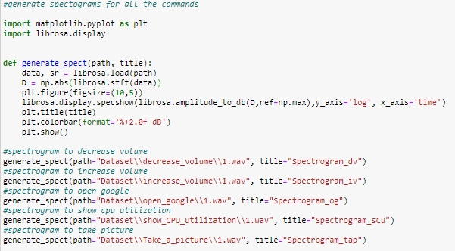
Audio Pre-processing
Pe r sona l
Vo I ce
As s I s t ant
The recorded voice commands are stored as .wav files and if we can get the spectrogram of the audio file, we can treat it as an image and feed it into a CNN to classify the audio. Library librosa can easily generate spectrograms for the audio with the library. The following code is used to generate the spectrogram.
GNR-652

Slide 7
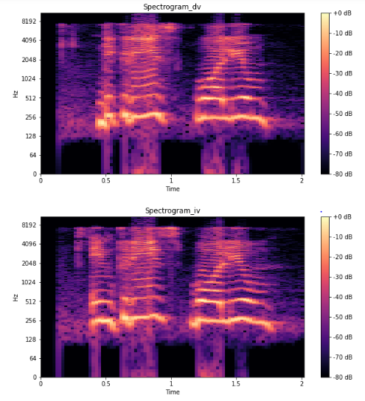
Dataset Generation
Pe r sona l
Vo I ce
As s I s t ant
In order to generate the spectrogram, we take the Short-time Fourier transform of the audio data. Fourier transform is used to convert a signal from the time domain to the frequency domain, we do this in order to know how much the signal is varying.
The five Spectogram generated are shown below:
GNR-652

Slide 8
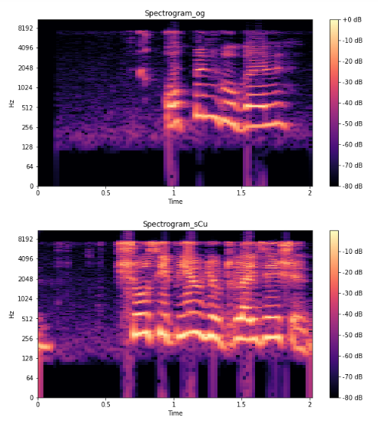
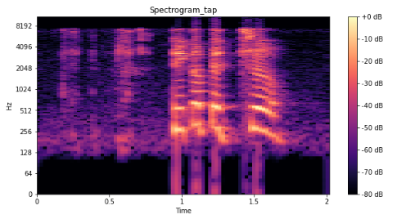
Dataset Generation
Pe r sona l
Vo I ce
As s I s t ant
Spectrogram_og: “Increase Volume”
Spectrogram_dv: “Decrease Volume”
Spectrogram_og: “Open Google”
Spectrogram_sCu: ”Show CPU Utilization”
Spectrogram_tap: ”Take a Picture”
GNR-652

Slide 9
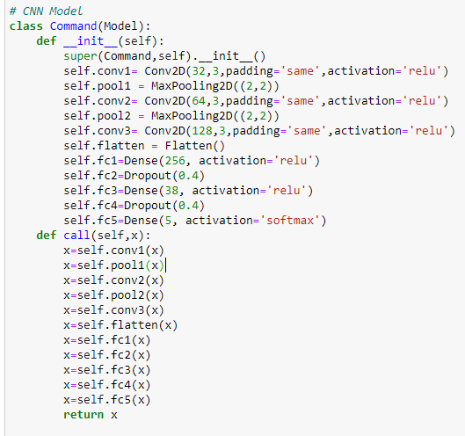
Building the Model
Pe r sona l
Vo I ce
As s I s t ant
Now that we have saved our audio samples and its corresponding labels into a .npy file, we can just load them whenever we want instead of generating spectrograms every time.
Before building the model, we shuffle and split the data into training and testing sets. We also convert the labels into one hot encodings.
We can now train our model for 10 epochs, we evaluate our model on cross-entropy loss and use RMSProp as our optimizer.
GNR-652

Slide 10
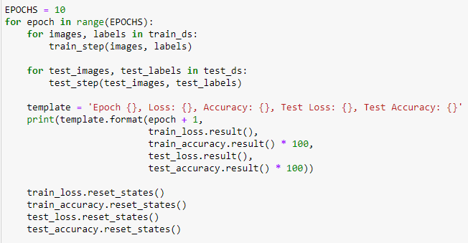
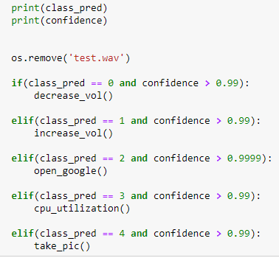
Automating the Task
Pe r sona l
Vo I ce
As s I s t ant
We use the microphone of our laptop to continuously record the audio and split it into 2-second samples and feed it into our model for prediction. If our model is able to classify the command with a high confidence score, we perform that task. The following are the working codes for performing each command through python.
GNR-652

Slide 11
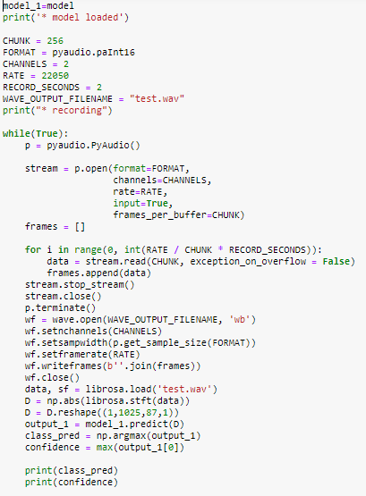
Automating the Task
Pe r sona l
Vo I ce
As s I s t ant
We now write a code that can indefinitely listen for voice commands through the laptop microphone and split it into 2-sec interval and use that sample to get a prediction from the CNN model. If our CNN model is able to classify a sample with a high confidence score we execute that task. The code is given below.
GNR-652

Slide 12
Result and Evaluation
Pe r sona l
Vo I ce
As s I s t ant
The accuracy of the train and test dataset is generated as follows:
The test accuracy of our model is approx 95%.
Please click on the video below to watch the demo of our Person Voice Assistant.
* If does not play then please find the .mp4 video in the zip
GNR-652

Slide 13
Conclusion and Reference
Pe r sona l
Vo I ce
As s I s t ant
This is just an example of what we can do. We can also choose to automate different tasks through different commands and even expand the number of commands and still get good accuracy.
https://towardsdatascience.com/build-your-first-voice-assistant-85a5a49f6cc1
https://towardsdatascience.com/build-your-personal-voice-assistant-cec7785508da
https://www.technoarete.org/common_abstract/pdf/IJERCSE/v6/i7/Ext_23897.pdf
https://github.com/raszidzie/TARS
https://in.springboard.com/blog/natural-language-processing/
https://github.com/sparshg17/DESKTOP-VOICE-ASSISTANT/blob/master/untitled0.py
https://github.com/Shellhead007/F.R.I.D.A.Y-Virtual-Assistant-/blob/master/tts.py
https://github.com/IbrahimEzzatEisa/Personal-Assistant
https://github.com/MannyBamrah/PersonalAssistant-Cadbury
https://github.com/nikitametha/NLP-based-Assistant
https://github.com/ggeop/Python-ai-assistant
https://www.activestate.com/blog/how-to-build-a-digital-virtual-assistant-in-python/
https://towardsdatascience.com/natural-language-processing-nlp-for-machine-learning-d44498845d5b
https://www.youtube.com/watch?v=xvqsFTUsOmc&t=4260s
https://github.com/hmahajan99/Text-Classification
https://github.com/lucko515/speech-recognition-neural-network
GNR-652

Slide 14
Thank You!!

